Slide 1
Smart Cities Project
Data Viz
By Emmanuel Enock

Slide 2
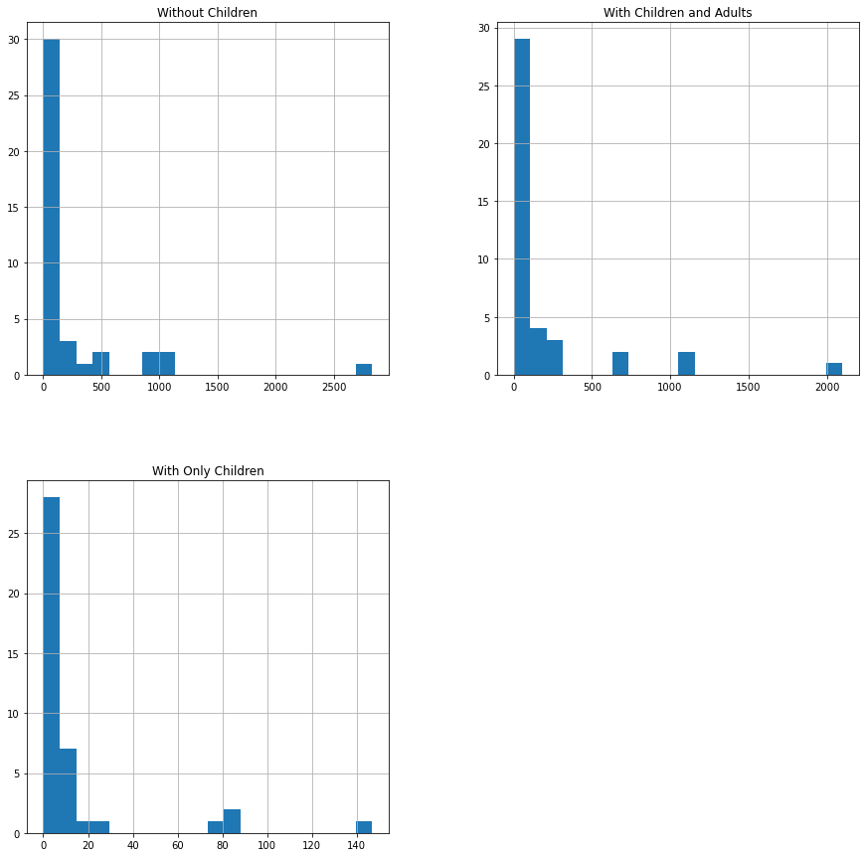
2019 P.E.H. Homeless shelter Data
HISTOGRAM
The histograms provides a basic sketch of where outliers occur in the various quantitative data columns. Within the data the graphs basically helps us visualize the amount of outliers in our data for 2019.

Slide 3
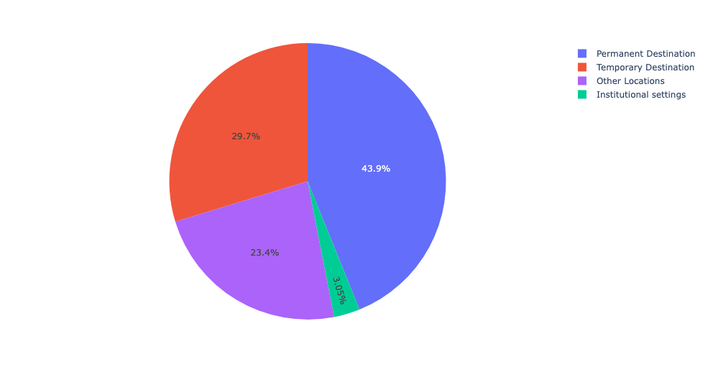
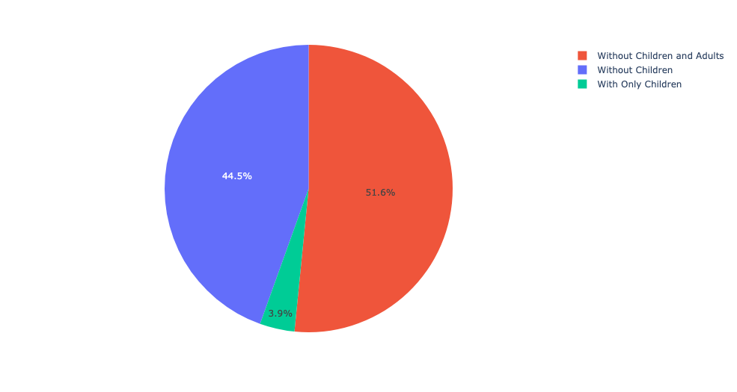
2019 P.E.H. Homeless shelter Data
In 2019 we can see that there's a good percentage of people coming into the homeless shelter and when they leave they go into permanent housing.
We see that there’s a larger percentage of people going into permanent housing and temporary housing falls in 2nd.
This pie chart on the right further analyzes the types of people that are in permanent housing that way we can understand who needs more attention and support. We can establish the fact that people without children and adults seem to be getting into permanent housing more than homeless people without children and so on.
Permanent Destinations chart

Slide 4
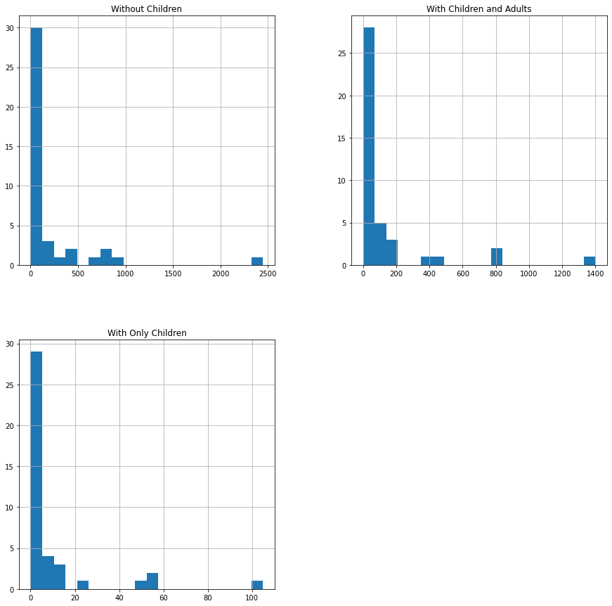
2020 P.E.H. Homeless shelter Data
HISTOGRAM
The histograms provides a basic sketch of where outliers occur in the various quantitative data columns. Within the data the graphs basically helps us visualize the amount of outliers in our data for 2020.

Slide 5

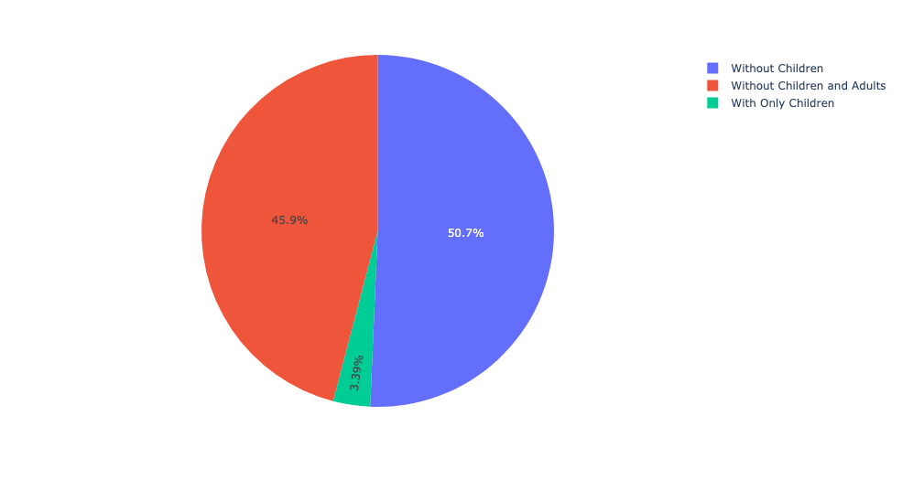
2020 P.E.H. Homeless shelter Data
In 2020 we see a decrease in people going into permanent housing compared to 2019, but since we are in the pandemic this is expected, also we see an increase in people going into temporary housing which may have resulted from people coming out of permanent housing into temporary housing.
We also notice an increase in homeless people going into institutional setting compared to 2019, and this not good and since were in the pandemic at this time, we are affected by this.
The percentage of homeless people going into permanent housing has decreased with people without children and adults.
We need to looking into these people without children and adults and find ways to help more of them find permanent housings
Permanent Destinations

Slide 6

2021 P.E.H. Homeless shelter Data
HISTOGRAM
The histograms provides a basic sketch of where outliers occur in the various quantitative data columns. Within the data the graphs basically helps us visualize the amount of outliers in our data for 2021.

Slide 7
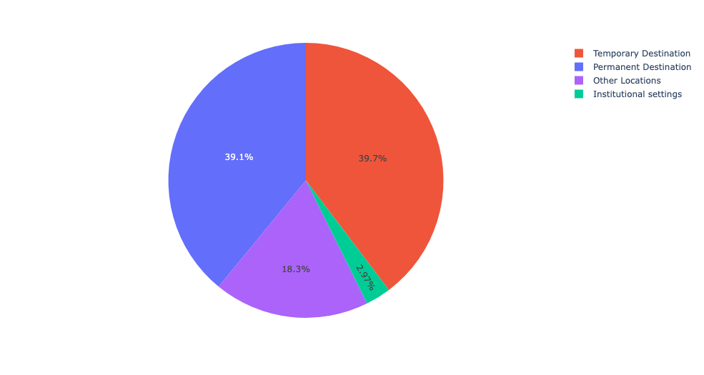

2021 P.E.H. Homeless shelter Data
Unfortunately we see another decrease in people going into permanent housing where it goes from 42.6% in 2020 to 39.1% in 2021. This should indicate that we must make improvements in keeping data visualizations like these to tell us where we need to improve in the organization.
Also there's decrease in people going into institutional setting and that's good, it's a very small percentage but its seems to be decreasing compared to 2020. Which shows how much the pandemic affected people and that we are doing something about it to get them back on there feet into temporary housing and eventually permanent.
Permanent Destinations

